Slide 1
Helical resonator
By 王雯

Slide 2
Goal
To trap ions within a Paul trap a high radio frequency voltage is applied to electrodes in order to provide the required electric potentials.
A helical resonator allows impedance matching between a radio frequency source and an ion tap enabling high voltages while reducing the noise injected into the system.

Slide 3
Goal
high voltage: resonate frequency → impedance matching
→ maximum power on load impedance
→ maximum voltage between the trap
Less noise: high Q → frequency selectivity
→ less noise

Slide 4
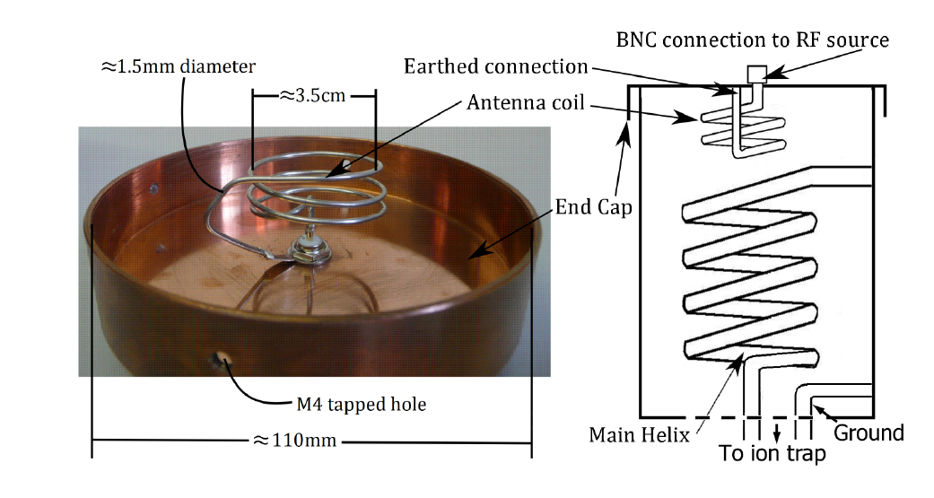
structure

Slide 5
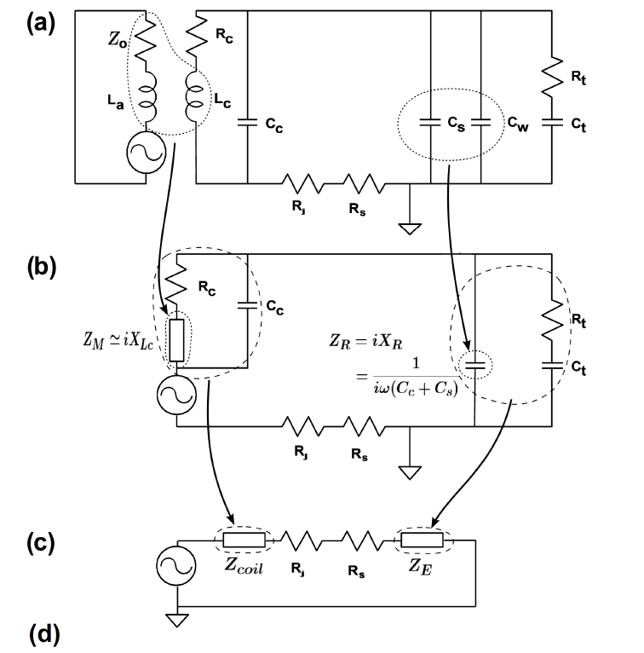
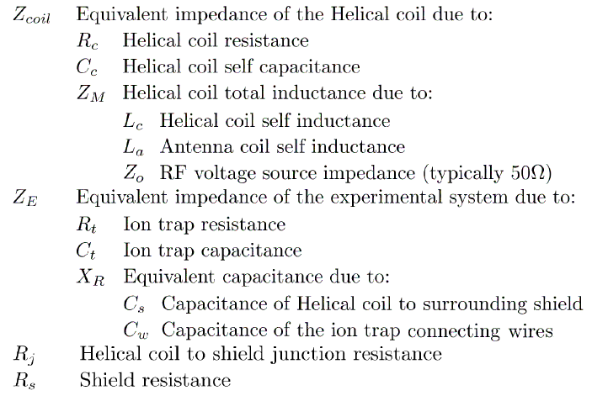
Structure

Slide 6
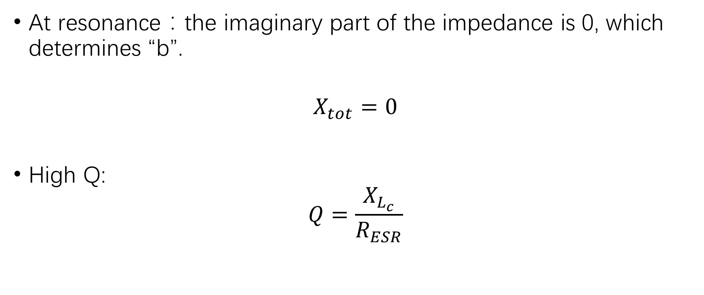
condition
At resonance：the imaginary part of the impedance is 0, which determines “b”.
$$X_{tot}=0$$
High Q:
$$Q=\frac{X_{L_{c}}}{R_{ESR}}$$

Slide 7
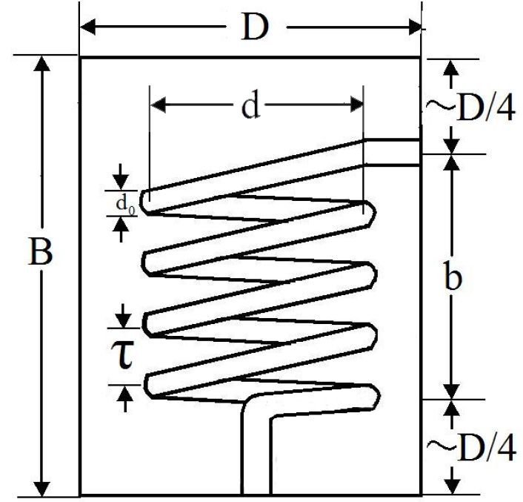
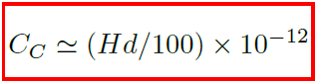
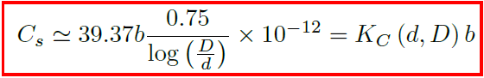
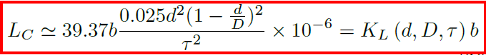
Empirical formula
If b>d

Slide 8
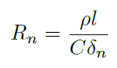
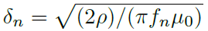
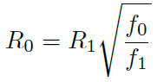
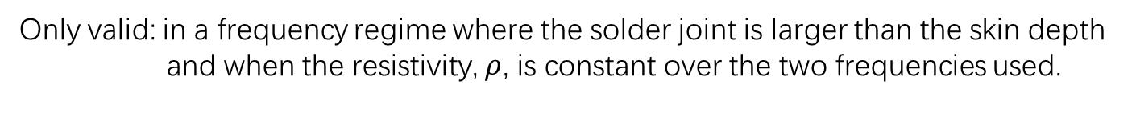
resistance
Only valid: in a frequency regime where the solder joint is larger than the skin depth
and when the resistivity, $ρ$, is constant over the two frequencies used.

Slide 9
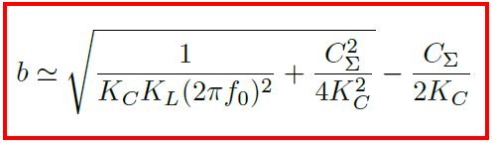
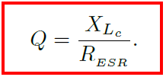
Result of calculation
Resonate →
Size and frequency →

Slide 10
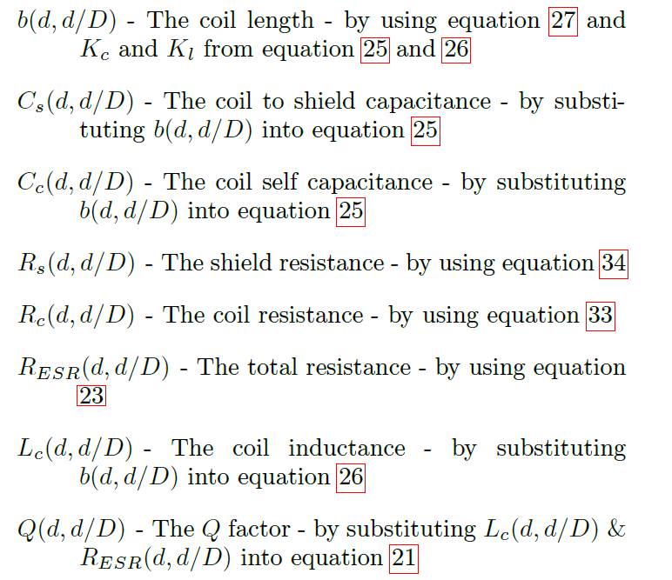
Specific process of calculation

Slide 11
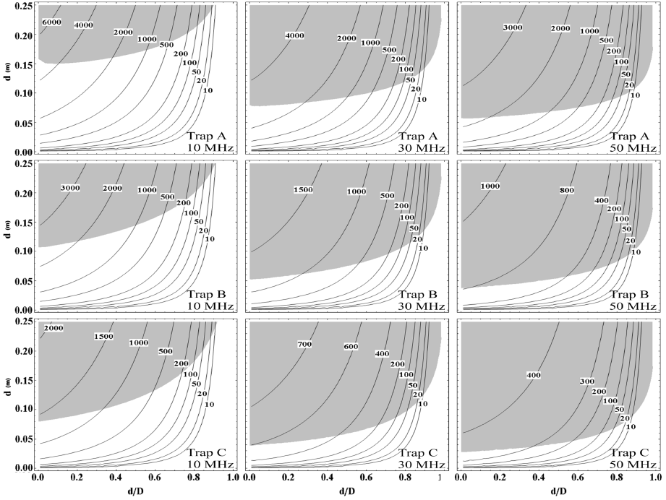
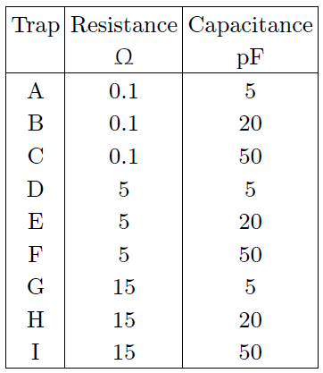
Result from the paper (？)

Slide 12
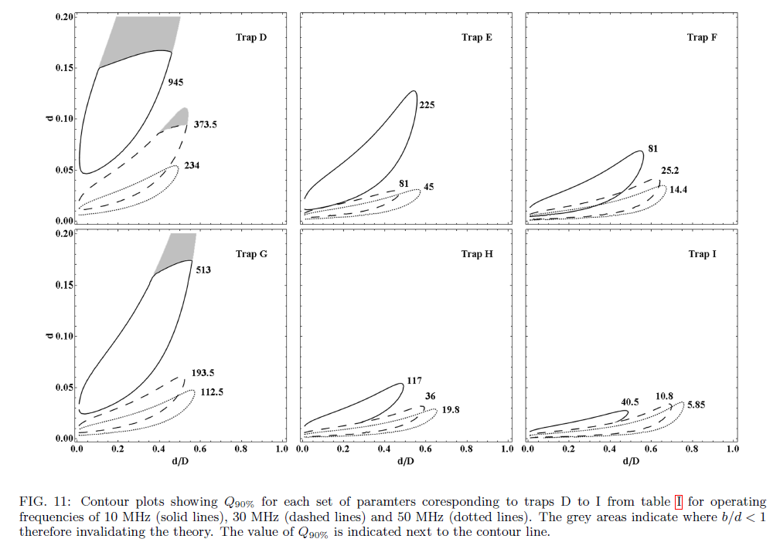
Result from the paper (？)

Slide 13
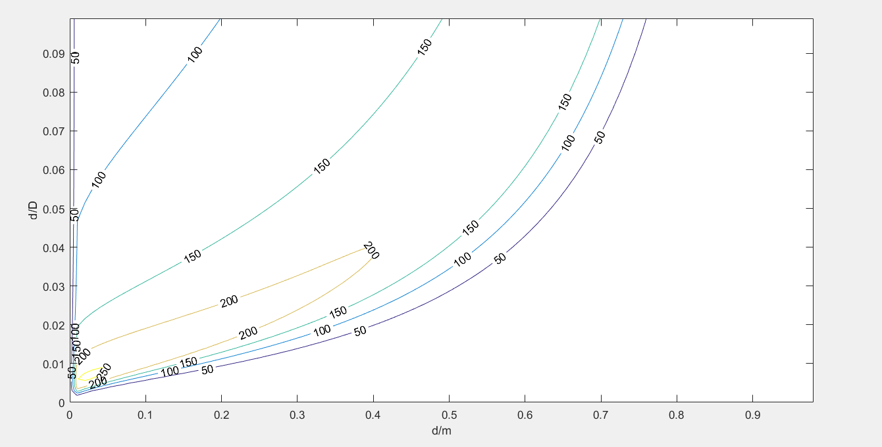
Our result about trap D

Slide 14
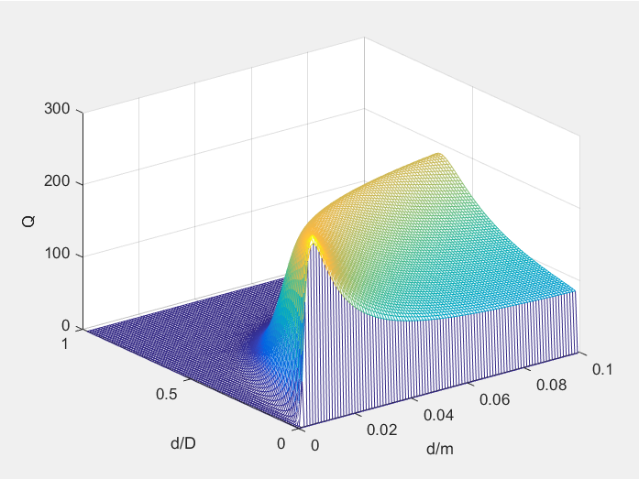
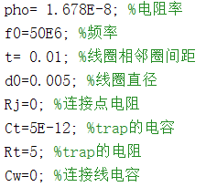
Our result about trap D

Slide 15
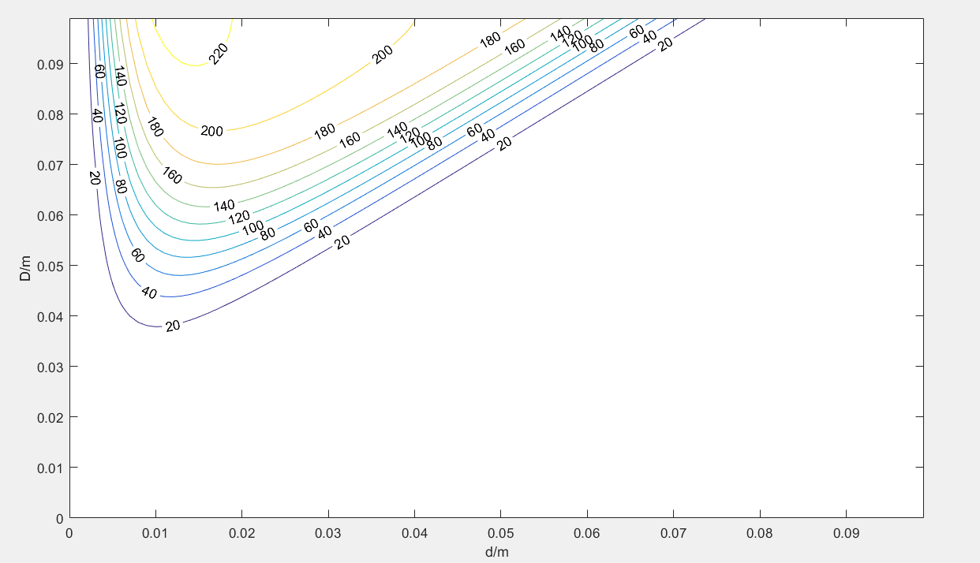
Our result of trap D

Slide 16
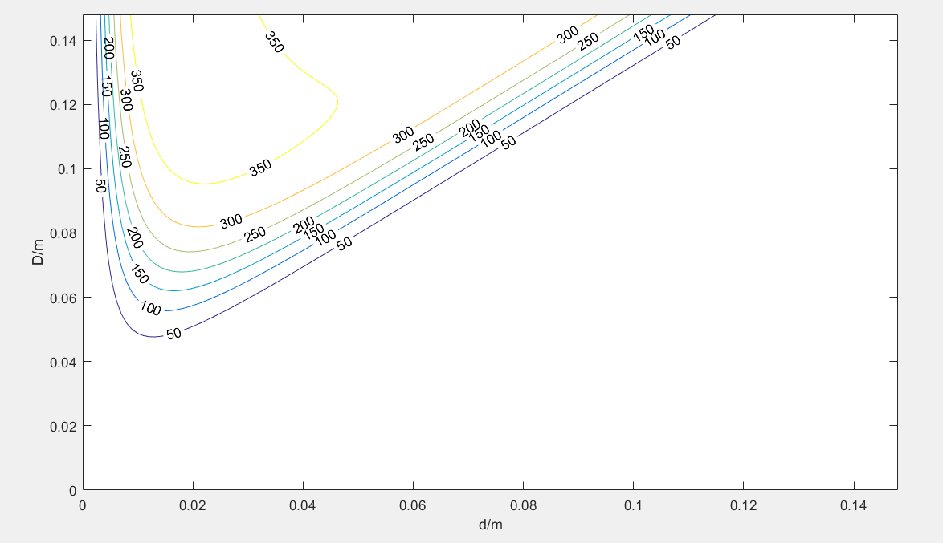
Larger range

Slide 17
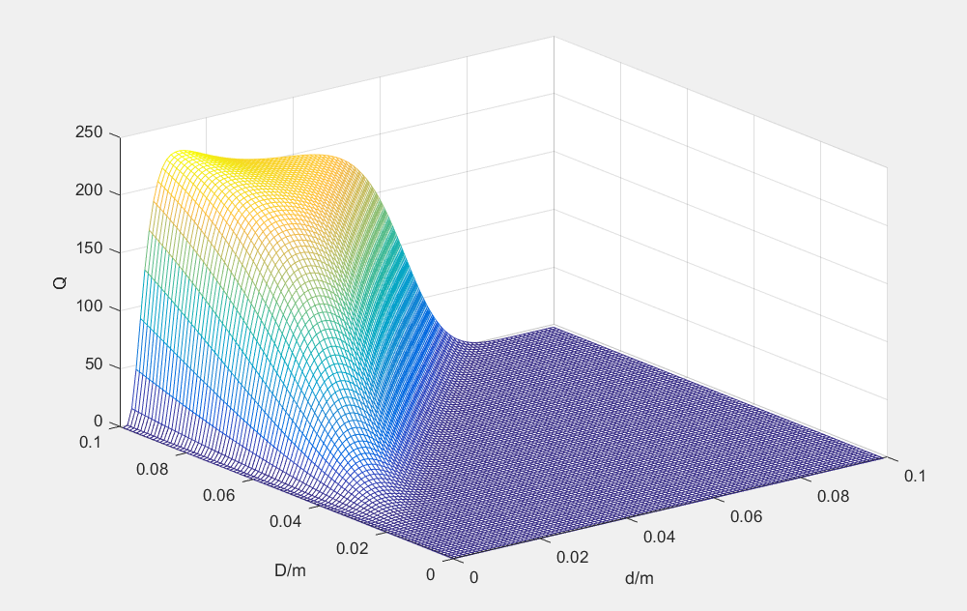

Slide 18
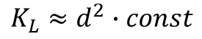
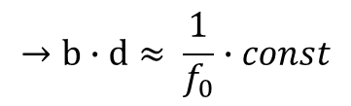
About the design
$$K_{L}≈d^{2}∙const$$
$$→b∙d≈ \frac{1}{f_{0}}∙const$$

Slide 19
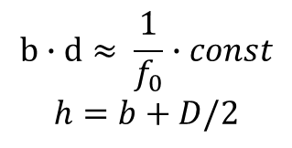
About the design
$$b∙d≈ \frac{1}{f_{0}}∙const$$
$$h=b+D/2$$
We want small size and a high Q:
So we choose a D less than 12cm so that we
can choose a larger d and at the same time a
Larger Q
⭐Notice: Although a larger D will be more likely to bring a higher Q,
It also may make h bigger and make the whole size bigger.

Slide 20
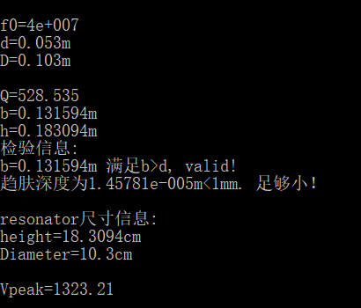
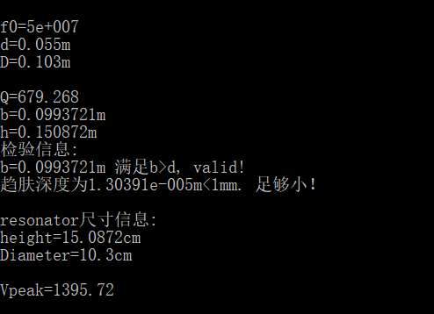
My design

Slide 21
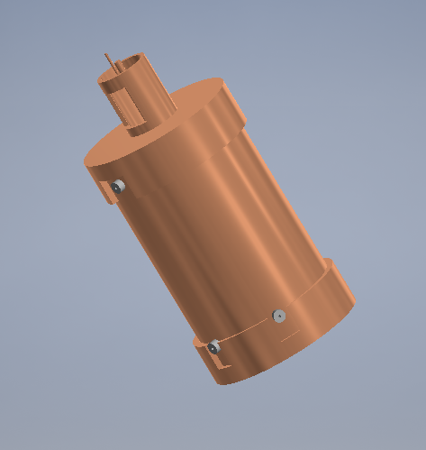
The end
About this design

Slide 22
Another design
Of resonators we may be interested in

Slide 23
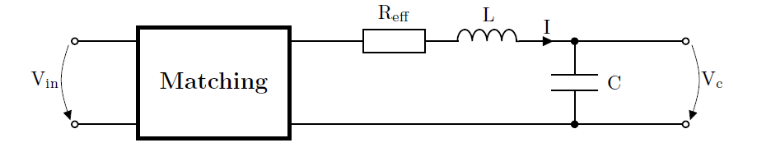
An RLC-series-resonator driven through a matching network
Coils produced with machines are desirable because the production process is reproducible.
Furthermore, we prefer toroid coils as they guide the magnetic field in their center, making them less
Sensitive to their environment.

Slide 24
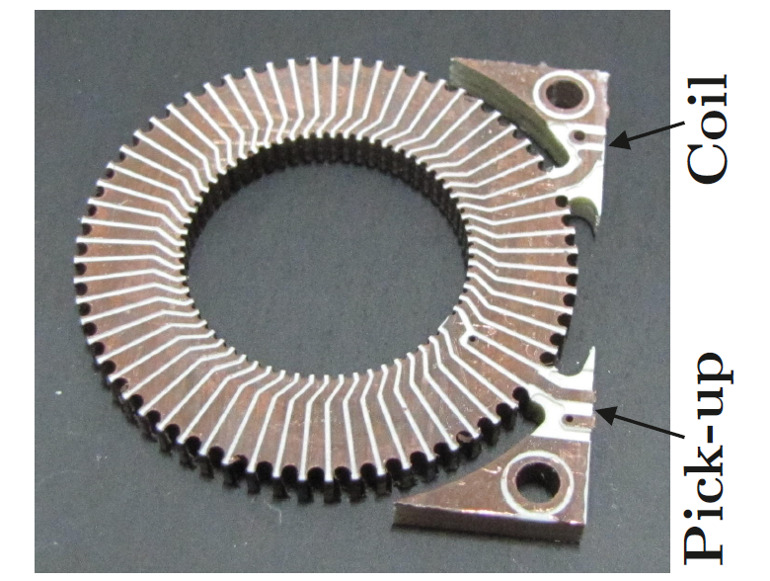
Different designs
1.PCB coils

Slide 25
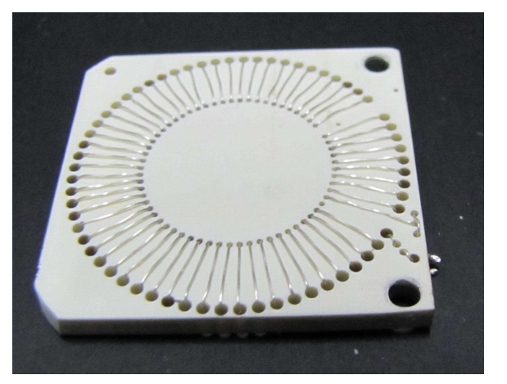
Different designs
2.wire coils

Slide 26
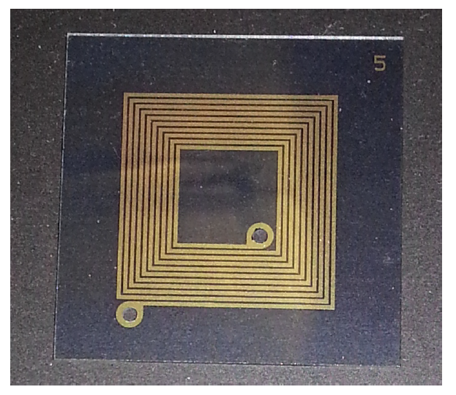
Different designs
3.Spiral coils

Slide 27
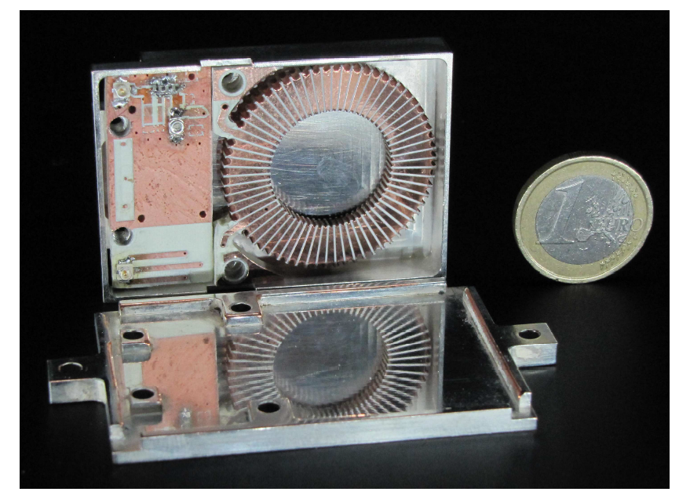
Small size

Slide 28
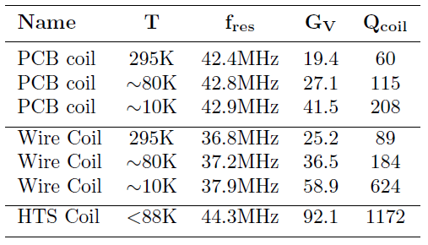
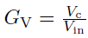
effective

Slide 29
Reference
[1] Siverns J D, Simkins L R, Weidt S, et al. On the application of radio frequency voltages to ion traps via helical resonators[J]. Applied Physics B, 2012, 107(4):921-934.
[2] Matthias F. Brandl, Philipp Schindler, Thomas Monz, Rainer Blatt, Cryogenic resonator design for trapped ion experiments in Paul traps, arxiv:1601.06699

Slide 30
The end
Thank you

